Slide 1
Interrupts

Slide 2
Interrupts
Computers often need to handle multiple tasks simultaneously or respond to external events promptly.
Interrupts are a mechanism that allows the CPU to suspend its current activities temporarily to respond to a specific event.
When an interrupt occurs, the CPU stops executing its current task and transfers control to a designated code segment called the Interrupt Service Routine (ISR) or Interrupt Handler.

Slide 3
Interrupts
Each type of interrupt is assigned an index from 0—255.
0—31 are for processor interrupts fixed by Intel
E.g., 14 is always for page faults
32—255 are software configured
32—47 are often for device interrupts (IRQs)
Most device’s IRQ line can be configured

Slide 4
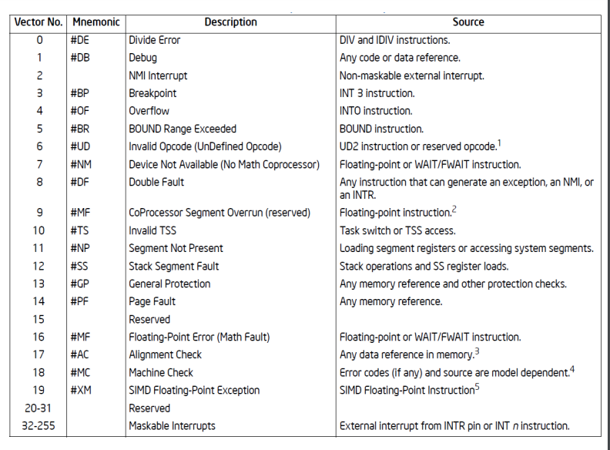

Slide 5
Why do we need interrupts?
Interrupts are a fundamental aspect of computer systems, and they serve several critical purposes that make them indispensable. Here are the key reasons why we need interrupts:
●Fix an abnormal condition
Page not mapped in memory
● Notifications from external devices
Network packet received
● Preemptive scheduling
Timer interrupt
● Secure interface between OS and applications
System calls

Slide 6
Cont…
Handling Asynchronous Events: Interrupts allow the CPU to respond to external events that occur asynchronously, such as user input from a keyboard, data arriving from a network, or a hardware device signaling the completion of an operation.
Efficient Resource Utilization: Instead of constantly polling hardware devices to check if they need attention, interrupts enable the CPU to perform other tasks until a device requires servicing.
Real-Time Response: Interrupts enable real-time systems to respond promptly to critical events without waiting for the completion of ongoing tasks.
Prioritization: Interrupts can be prioritized, ensuring that more urgent or important events are handled before less critical ones.
Exception Handling: Interrupts are used to handle exceptional conditions, such as division by zero, invalid memory access, or other errors encountered during program execution.

Slide 7
Types of Interrupts
Hardware Interrupts: Triggered by external hardware devices (e.g., keyboard, mouse, timer, I/O devices) to request the CPU's attention.
Software Interrupts: Invoked by software instructions (system calls) to request services from the operating system.
Exception Interrupts: Caused by exceptional conditions during program execution, such as division by zero or invalid memory access.

Slide 8
The Interrupt Cycle
Detection: An external device generates a signal (e.g., a hardware device sends an electrical signal) to indicate an interrupt condition or the CPU detects an exception condition internally.
Interrupt Request (IRQ): The signal is sent to the Interrupt Controller, which prioritizes interrupts and informs the CPU.
Interrupt Acknowledge: The CPU acknowledges the interrupt request and saves the current execution state on the stack.
Interrupt Handling: The CPU looks up the Interrupt Vector Table (IVT) to find the memory address of the corresponding Interrupt Service Routine (ISR) for the specific interrupt type.
Interrupt Service Routine (ISR): It is the code responsible for handling the specific interrupt. It performs the necessary actions for the interrupting device or condition.
Interrupt Return: After completing the ISR, the CPU restores the saved execution state from the stack and resumes the interrupted program.

Slide 9
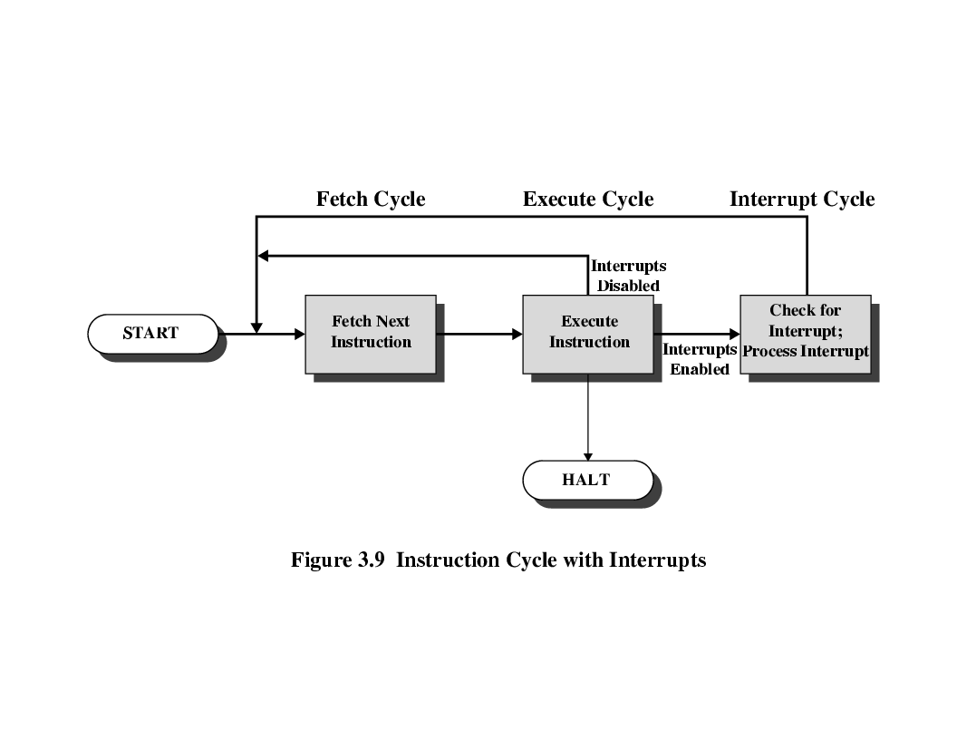
Instruction Cycle with ‘Interrupts Cycle’
To accommodate interrupts, an interrupt cycle is added to the ‘instruction cycle’.
In the interrupt cycle the processor checks to see if any interrupts have occurred, indicated by the presence of an interrupt signal.
If no interrupts are pending, the processor proceeds to the fetch cycle and fetches the next instruction of the current program.

Slide 10
Steps of ‘Interrupt Handler Process’
Hardware sends an electrical signal on a physical interrupt line.
Processor detects that signal and translates it into an interrupt request (IRQ) number.
Processor then jumps to interrupt handling code.
Software searches through its interrupt request table (stored in RAM) for entry or entries that match the IRQ.
If found, software jumps to the registered interrupt service routine (ISR).
If not found, software ignores interrupt.

Slide 11
Interrupt Handler and Multiple Interrupts
When multiple interrupts occur simultaneously or in rapid succession, it leads to the issue of interrupt handling.
To manage this, a priority system is often employed. Some interrupts are given higher priority than others.
If a higher-priority interrupt occurs while the CPU is handling a lower-priority interrupt, the CPU suspends the current ISR and begins executing the higher-priority ISR.
The priority of interrupts is typically configurable, and hardware may also include masking mechanisms to enable or disable specific interrupts.
Interrupt handling is time-critical, as delays in handling interrupts could lead to loss of data or missed events.

Slide 12
Multiple Interrupts (example)
There is a possibility that multiple interrupts can occur at a time.
For example, a program may be receiving data from communication line and printing results.
The printer will generate interrupt every time it completes a printer operation.
The communication line controller will generate an interrupt every time a unit of data arrives. (e.g. a character or a block of data)
In any case, it is possible for a communications interrupt to occur while a printer interrupt is being processed.

Slide 13
Two Approaches to Dealing with ‘Multiple Interrupts’
Disable interrupts (Maskable interrupt)
Processor will ignore further interrupts whilst processing one interrupt.
Interrupts remain pending and are checked after first interrupt (ISR) has been processed.
Interrupts handled in sequence as they occur. (e.g. data may be lost on a line)
Drawback, it does not take into account relative priority, or time critical needs.
Define priorities (Non-Maskable interrupt)
Low priority interrupts can be interrupted by higher priority interrupts.
When higher priority interrupt has been processed, processor returns to previous interrupt.
Reserved for critical events, that requires immediate attention.

Slide 14
Conclusion
Interrupts are vital for the efficient functioning of modern computer systems.
They allow CPUs to respond to external events promptly, handle multiple tasks simultaneously and efficient use of system resources.
Proper interrupt handling is crucial to ensure the stability and responsiveness of computer systems.
Without interrupts, computer systems would be much less capable, less responsive, and more resource-intensive.

